Slide 1
Welcome to our event!
Log in
Log out

Slide 2
You are a:
Normal
Employee
Sponsor
Back

Slide 3
As an employee,you are a:
Community officer
Volunteer
Musician
Back

Slide 4
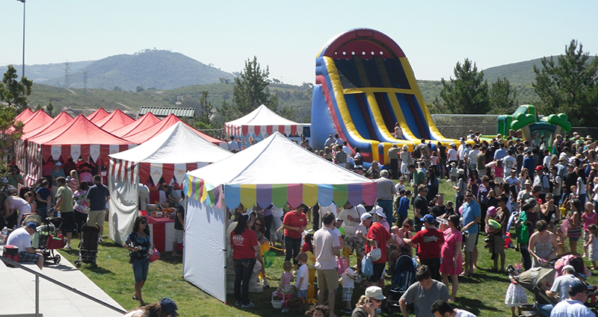
Normal
Finish
Name:
Age:
Sex:
What do you want to do at our event?
Have delicious food
Take part in sports event
Back

Slide 5
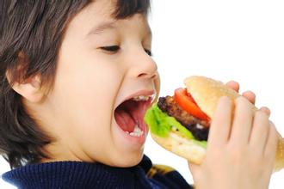
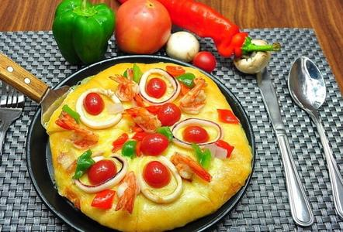
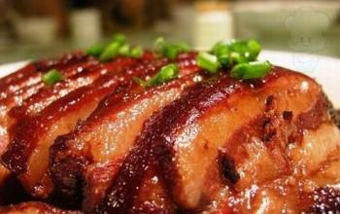
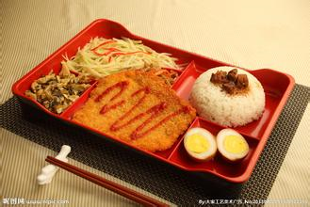
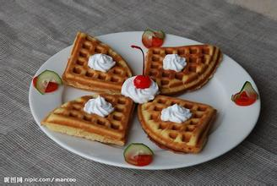
Have delicious food
Finish
Just click on the food you like
Back

Slide 6
Favour:People who likes to have pizza,espicially beef,because this pizza is all done by beef
Avoidance:Because this pizza is very pungent,so it is not suitable for people who likes to have light food.
Place:Space A1
See the other food

Slide 7
Favour:People who likes to have pork or bacon,it is very delicious
Avoidance:Because it is done by pork and bacon,it is not suitable for people who believe in Moslem
Place:Space A2
See the other food

Slide 8
Favour:People who want to have quick meal
Avoidance:Maybe there is no avoidance
Place:Space A3
See the other food

Slide 9
Favour:People who likes to have sweet food
Avoidance:Because it is very sweet,so it is not suitable for people who have diabetes
Place:Space A4
See the other food

Slide 10

Take part in sports event
Finish
Do you like sports?If so,just join us!
Football 8:00-11:00 Space:B1
Basketball 11:00-13:00 Space:B2
Pingpong 133:00-15:00 Space:B3
Back

Slide 11
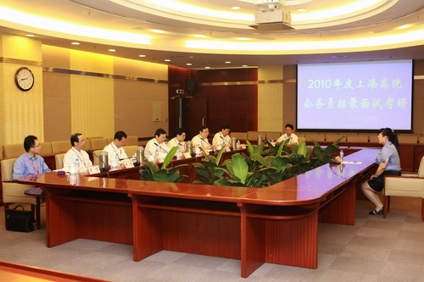
Community officer
Name:
Age:
Sex:
Your data isuploading,please wait for a minute……
Next
Back

Slide 12
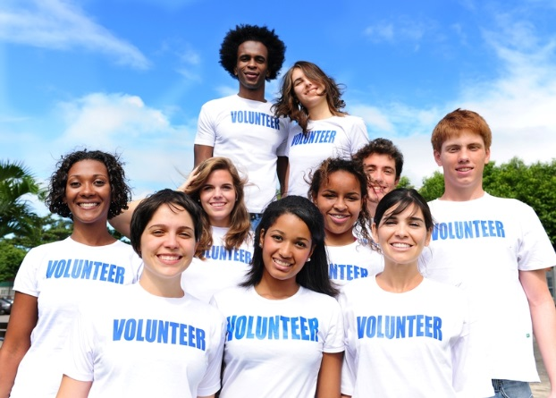
Volunteer
Finish
Name:
Age:
Sex:
Event:
Start Time:
Finish Time:
Back

Slide 13
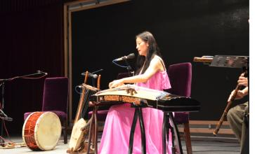
Musician
Finish
Name:
Age:
Sex:
Ability:
Start time:
Finish time:
Expected salary:
Back

Slide 14
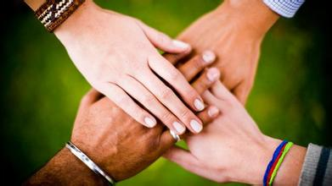
Sponsor
Finish
Company name:
Goods name:
Goods price:
Click here to upload your advertisement
Back

Slide 15
Your work is to look after space A1 from 8:00 to 10:00!
Finish

Slide 16
Advertisemnt uploading......
Finish

Slide 17
Thanks for using!

